Slide 1
Nursery Topic Web-Spring 2
Come Outside!
Key Books this term:
5 weeks
Key questions:
What is a garden?
Do you have a garden?
What plants do you have in your garden?
What do we notice in the Spring?
What kind of plants might we see during the Spring time?
Where do fruit and vegetables grow?
What kinds of fruit and vegetable do you like?
What would you like to have in your dream garden?
How can we plant a bean/seed?
What does a seed need to grow?
Key questions:
Who is Jasper?
What is Jasper trying to do?
What does he do first, next, last?
What does Jasper need to grow a beanstalk?
What does Jasper do wrong?
What does Jasper do right?
What does Jasper grow?
What does Jasper’s bean need to help it grow?
Key Questions:
Which book does this story remind us of?
What is Easter?
How do we celebrate Easter?
What do they find on the hunt?
Why are they carrying nets and baskets?
Why is the baby bunny in a wheelbarrow?
What kind of eggs do they find?
Which animals do they see on the way?
How many eggs do they find?
Can you see any signs of Spring?
Who do they run away from?
Key vocabulary linked to the book:
Monday, Tuesday, Wednesday, Thursday, Friday, Saturday, Sunday, beanstalk, bean, planted, watered, dug, raked, sprayed, hoed, slugs, snails, mowed, giants
Key Vocabulary linked to the book:
Grow, water, dream, plant, jug, tea pot, block of flats, lift, rake, spade, roof, laptop, garden, Spring, new life, plant,
Seed, bean, soil, water, sunlight, roots, stem, petals, flower, leaves, buds
Key Vocabulary linked to the book:
Egg, hunt, Easter, lamb, over, under, around, through, excited, chick, bees, ducks, wolf, wheelbarrow, basket, net
Save the date!
Nursery Stay & Play
Tuesday 26th March
9.00-10.00
Please upload videos or photos of your child’s learning at home onto Class Dojo. We love to see what they have been doing at home.
World Book Day: Thursday 7th March
Dress up as one of your favourite characters and bring in your favourite book.

Slide 2
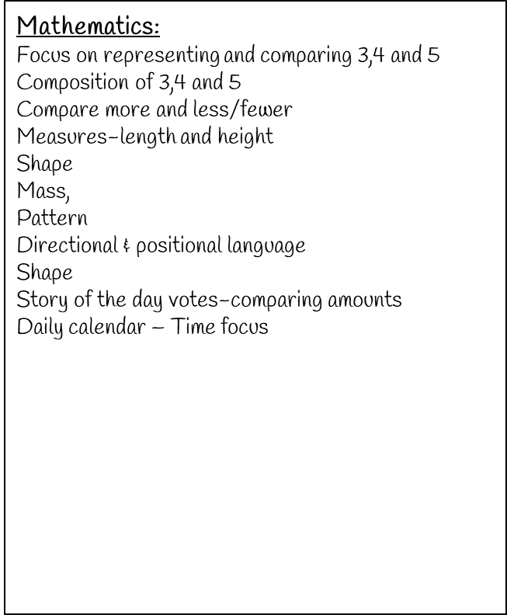
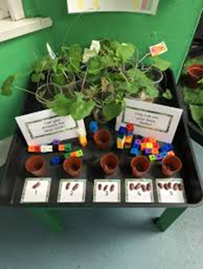
Personal, Social and Emotional Development:
Continue to follow our class routines and follow our visual timetable
Use our ‘Choose it. Use it. Put it away’ mantra to help us respect our things and to keep our classroom tidy
Continue to line up and sing our lining up song
Begin find solutions to conflicts and ask a grown up for help if necessary. Learn to say, ‘Stop, I don’t like that.’
Begin to follow rules more independently and understand why they are important.
Become more accepting of the need to share and turn take. (Continue using the sand timer with less support from adults)
Use taught strategies and our calm area to help with at self-regulation. Know when to come for an adult for help.
Develop a sense of responsibility. The children will have independent snack and will follow our snack routine carefully Children will talk about keeping healthy.
Physical Development:
Continue to develop self help skills including washing
hands, wiping noses and putting on coats and shoes. There will be a big focus on fastening our own zips.
Continue following Squiggle whilst you Wiggle to develop pre writing skills and to develop gross motor skills. Focus handwriting patterns:
Move 7 The hook
Move 8 Laid down 8, the stand it up
straight
Move 9 Straight line
Daily Dough Disco: Continue to learn simple but fun exercises to strengthen hand and finger muscles
Finger Gym: Children will do daily activities available throughout the provision to strengthen hand and finger muscles. E.g. Using tongs to pick up and transfer peas
Write in different mediums: Cornflour, paint, shaving foam, mud
Continue to practise forming letters from their name
Learn about keeping fit and healthy
Play ring games and parachute games. Take part in short yoga sessions, join in with action songs and games to improve co-ordination and control.
Weekly P.E: Focus – Occupational Therapist program to develop core strength.
Scissor skills: Children will practise using scissors to make snips in paper, cut along lines and cut around large and small shapes.
Communication and Language:
Listen to longer stories and talk about what has happened.
Take a library book home each week to share and talk about with members of their family.
Sit and listen, making relevant comments. Ask questions.
Answer who, what and why questions.
Keep play going by responding appropriately with relevant questions, comments and answers and encourage children to use longer sentences.
Expose children to new language through high quality interactions, books, rhymes and songs.
Encourage the children to turn take in a conversation for more than one turn. Adults will model this continuously through play.
Encourage and model the use of words to make their feelings known instead of making sounds/noises to express themselves. This includes when they disagree over something.
Children will begin to express their point of view. Adults to ask children’s opinions through high quality interactions.
Daily Little Wandle sessions. (See Little Wandle Phonics on our class page)
Talk Boost interventions to support those children who need extra support in developing their communication and language skills.
Please help your child by ensuring they have NO LACES or BUCKLES on their shoes. They must be able to put their shoes on independently.

Slide 3
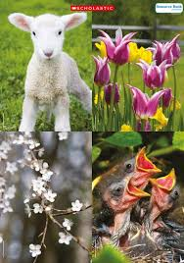
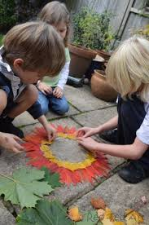
Literacy: Reading & Writing:
Little Wandle ‘Foundations for Phonics:
Tuning into sounds
Rhyme Time
Oral Blending
Foundations for a Love of Reading
The children will continue learning to recognise their name.
Children will vote for a story each day.
Children will continue to learn and recite poems from the Poetry Basket.
Children will continue to be emersed in stories, rhymes, poems and songs. They will listen to 2 or 3 stories per day and will be able to join in with repeated parts and fill in missing words.
Children will begin to make predictions about books, begin to understand the structure of stories, talk about some key events and name some characters.
Children will learn that print has meaning through adults pointing out print in the environment, in books, logos and familiar signs.
Children will begin to understand that English text is read from top to bottom and left to right.
Children will learn about parts of a book and page numbers.
Children will give meaning to the marks they make.
Children will use marks they can make (letters/pre writing patterns) to create shopping lists, cards, letters, messages etc.
Children will write some recognisable letters from their name
Library:
The children will bring a new library book home each week and a reading diary to complete together at home. Each child will have a regular ‘Book Talk’ session with an adult 1:1 to talk about the library book they have read that week.
The Everywhere Bear:
The children will each have a turn at bringing home our class bear and story. This will be in place of a library book. You can send in your ‘Adventures of The Everywhere Bear’ via class Dojo.
Understanding the world:
Signs of Spring
New life
Easter
Easter
Growing Gardening
See our class page for further information on Little Wandle and how you can support your child at home
Expressive Arts and Design:
Learn to mix colours
Do observational drawings and paintings with a focus on flowers using Van Gogh as inspiration.
Use watercolours
Make transient art and look at the work of Andy Goldsworthy
Create Easter nests, baskets and cards
Design and create their own models using junk materials
Use a range of joining materials appropriately
Let your child have plenty of opportunities to get creative at home with chalks, paints, pens and collage. This will
help their fine motor skills.

