Slide 1
Teach reading: change lives
Parent workshop: Phonics and early reading in Reception, Phase 3
(Spring 1)
Notes:
For this presentation, you will need to download and print out the following resources and information for parents:
the parent handout ‘Your child’s reading journey – Reception Spring term’
the Phase 2 and 3 grapheme mat
‘Phase 3 tricky words: Reception Spring term – Information for parents and carers’ – or parents can access this in the ‘For parents’ area of the Little Wandle website.
You will need a flipchart and access to the Little Wandle and Collins websites.
You may also wish to have a copy of the Little Wandle Glossary to hand (in Getting started/Teaching).

Slide 2
Phonics is:
making connections between the sounds of our spoken words and the letters that are used to write them down.
Notes:
Slide purpose:
To give simple a definition of phonics
Suggested script:
So what is phonics?
Read the slide.
It sounds complicated but it really isn’t!
Let's recap some important words that will help you understand phonics...

Slide 3
Terminology – a recap!
Phoneme
Blend
Grapheme
Segment
Digraph
Trigraph
Notes:
Slide purpose:
To recap key terminology
Suggested script:
Explain what each word means – use our glossary to help: https://www.littlewandlelettersandsounds.org.uk/resources/my-letters-and-sounds/getting-started/

Slide 4
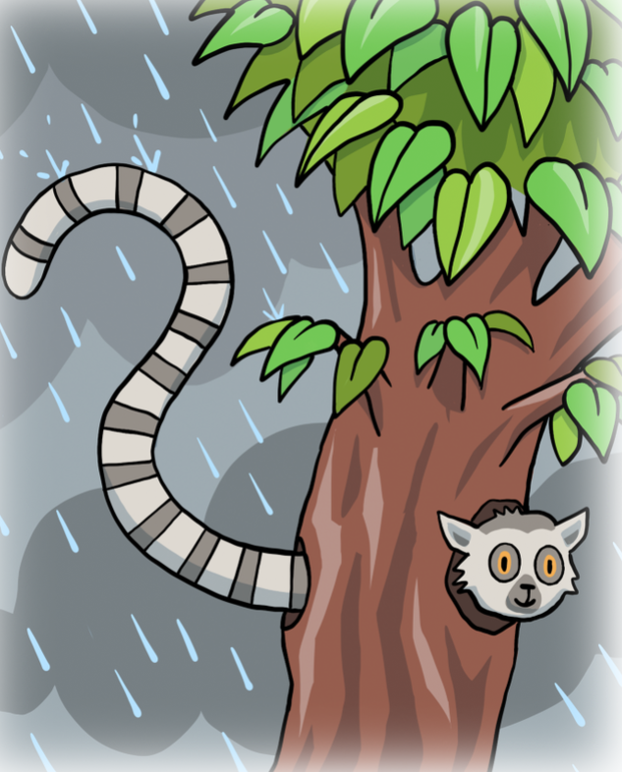

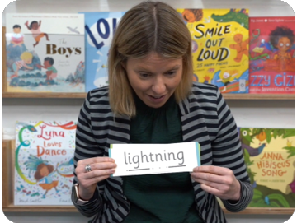
This term we are teaching Phase 3
Last term we taught your child to blend and read words with Phase 2 graphemes.
In Phase 3 children learn:
the vowel digraphs and trigraphs
to read words containing the Phase 3 digraphs and trigraphs
to read longer words (‘chunking’).
Notes:
Slide purpose:
To introduce Phase 3
Suggested script:
Read the slide.
Let's look at each of these in a bit more detail...

Slide 5
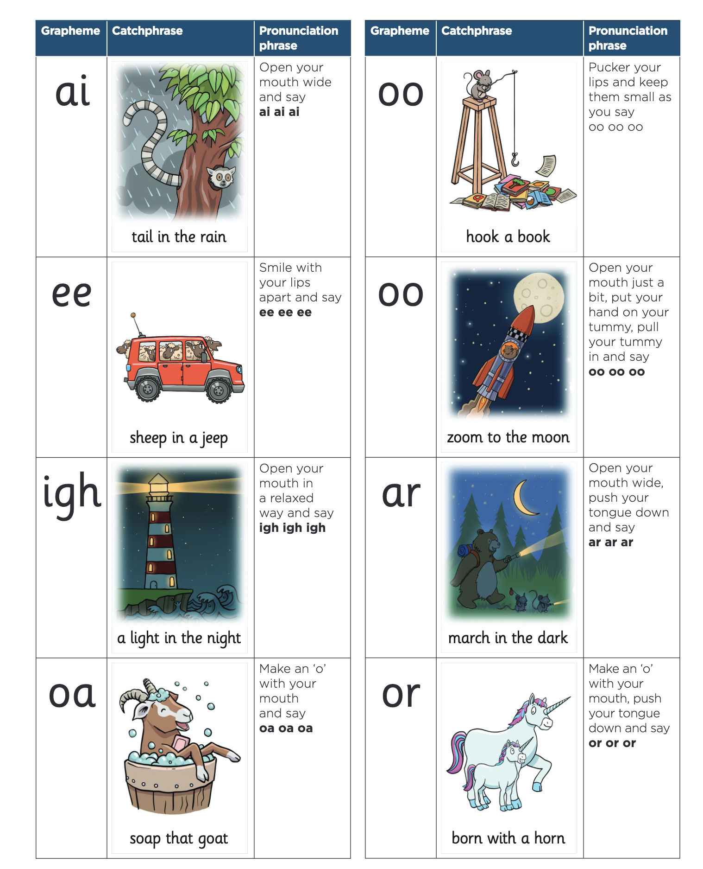
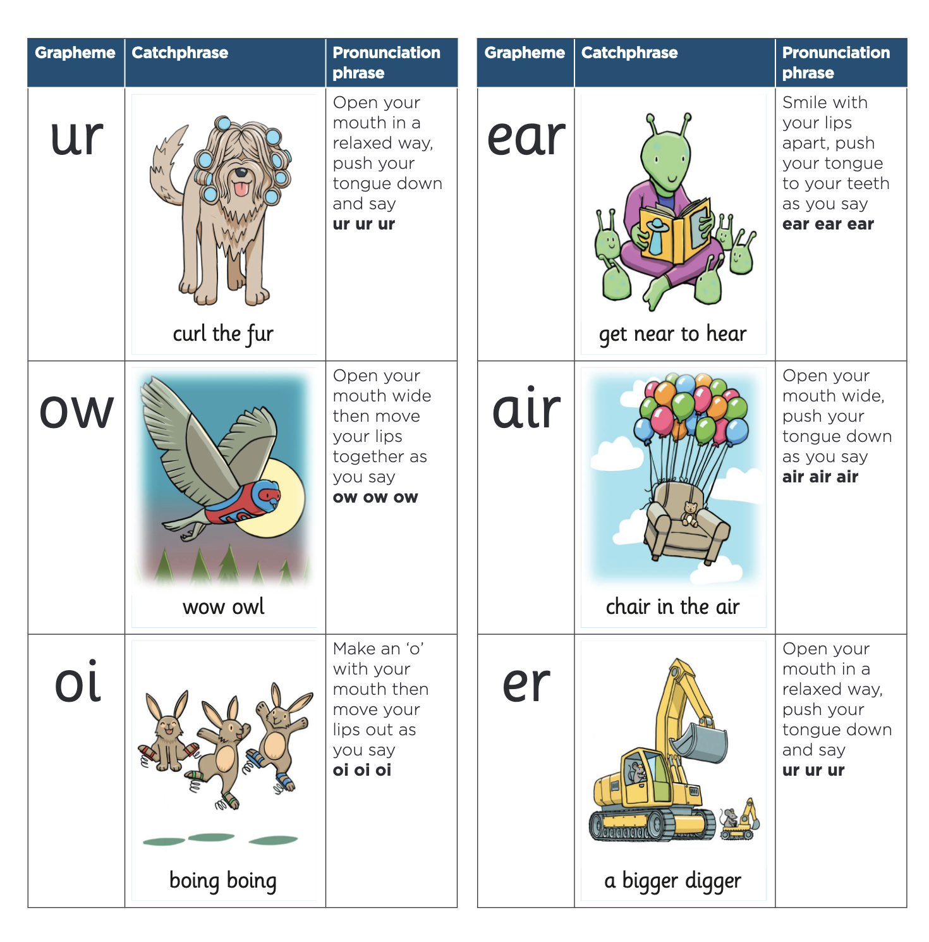
Phase 3 vowel digraphs and trigraphs
Notes:
Slide purpose:
To provide an overview of the Phase 3 vowel digraphs and trigraphs
Suggested script:
We usually teach four new sounds a week and have a review lesson on a Friday.
You will get a list of the sounds that we are learning to have at home. This will help you with formation (handwriting) and pronunciation.
In Phase 3, each sound has a linking catchphrase so that children can remember the graphemes more easily, e.g. zoom to the moon.

Slide 6
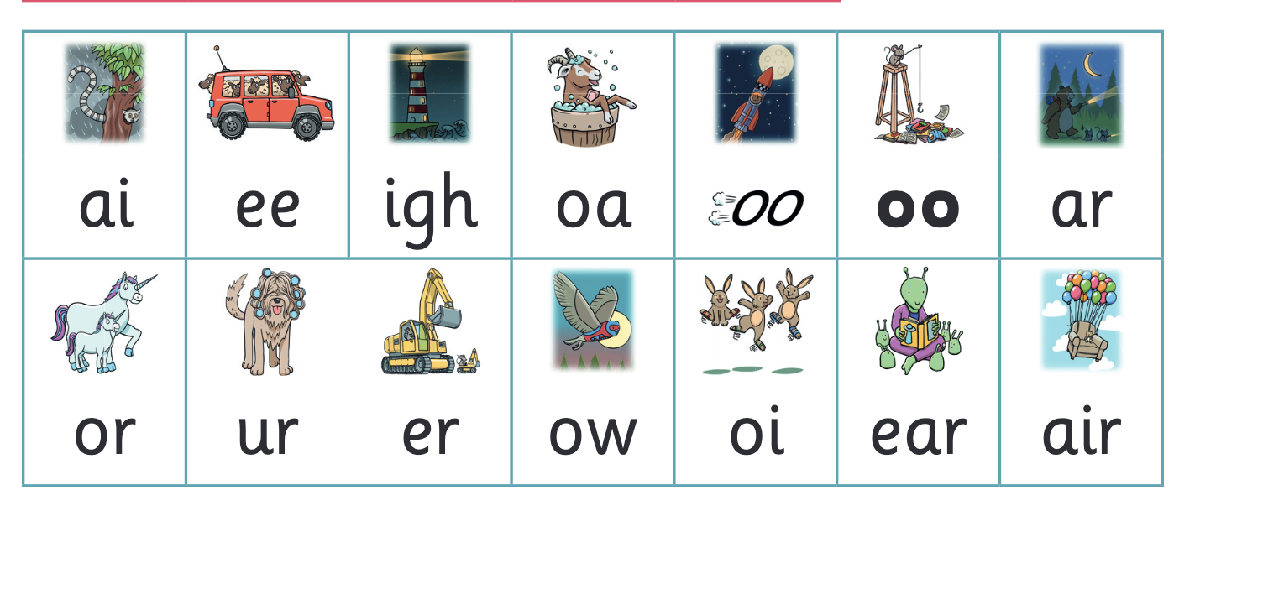
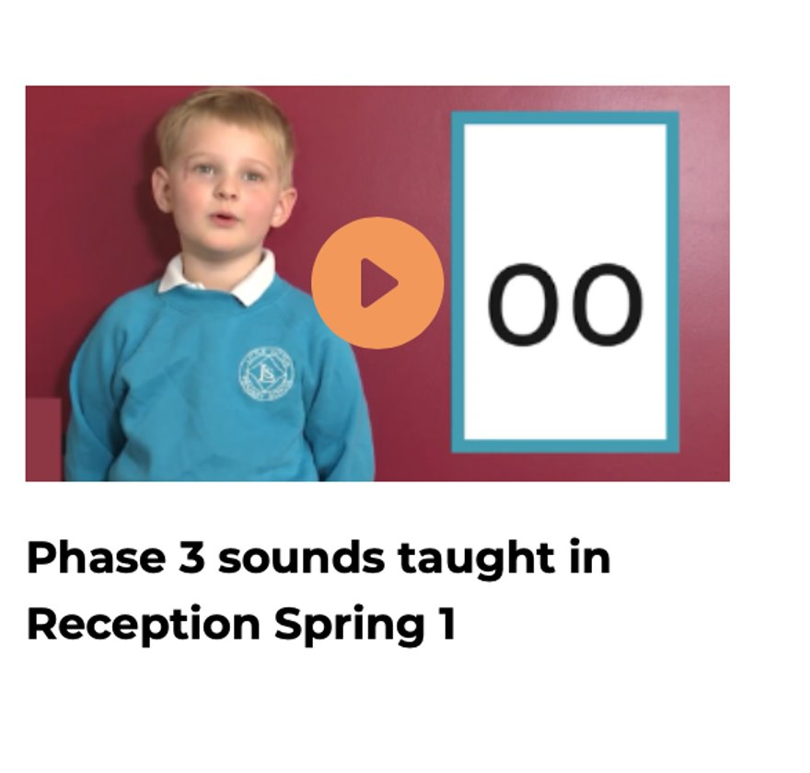
Let’s say the Phase 3 sounds
Notes:
Slide purpose:
To practise the Phase 3 sounds
Suggested script:
Give out the parent handout and the Phase 2 and 3 grapheme mat.
Play the videos and teach the parents the Phase 3 sounds.

Slide 7
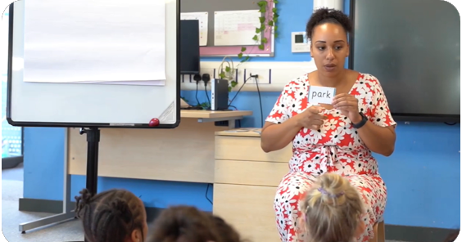
Reading words with vowel digraphs/trigraphs
During Phase 2 we taught your child to blend using the teacher-led blending approach.
Now they can start to blend independently.
Children are taught to spot the digraph/trigraph in words first.
Notes:
Slide purpose:
To introduce blending
Suggested script:
Teacher-led blending is teaching children how to blend, directed and demonstrated by the teacher.
It is repeated daily in the Autumn Term.
**Note – some children may still need teacher-led blending going into Phase 3**
Show how to read a Phase 3 review word, e.g. moon – What’s the digraph?
Sound and blend, repeat. Then blend in your head.
If it’s a new word, sound button side of the card is shown as a scaffold.

Slide 8
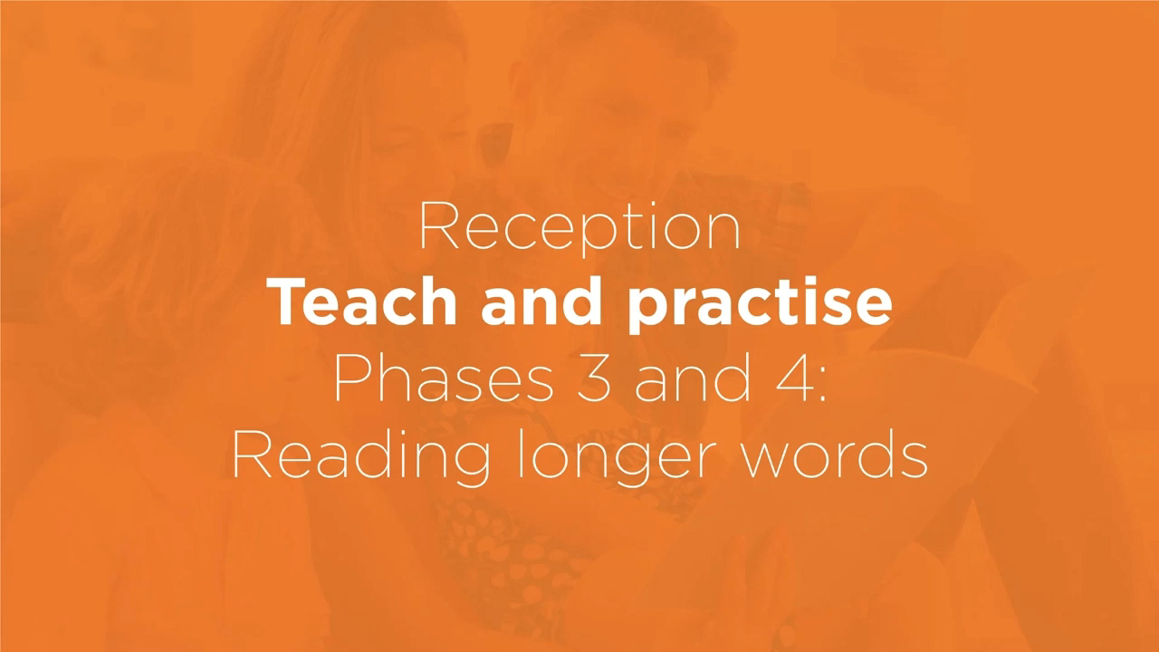
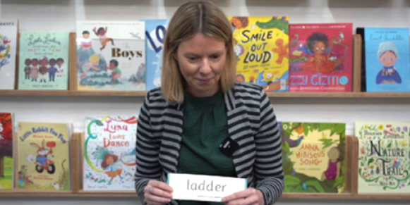
Reading longer words
During Phase 3, we start teaching children how to read longer words.
We do this using a method called chunking.
Notes:
Slide purpose:
To provide an overview of blending longer words
Notes:
Read the slide.

Slide 9
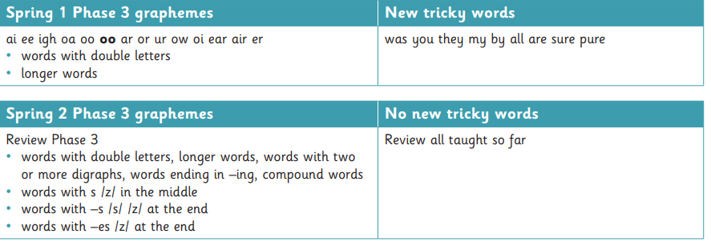
Phase 3 tricky words
Notes:
Slide purpose:
To introduce tricky words
Suggested script:
As you can see, there are only nine tricky words taught this term.
Teaching is focused on secure Phase 3 grapheme recognition. All the graphemes are taught in the first half of Spring, so that they can be regularly reviewed until Easter.

Slide 10
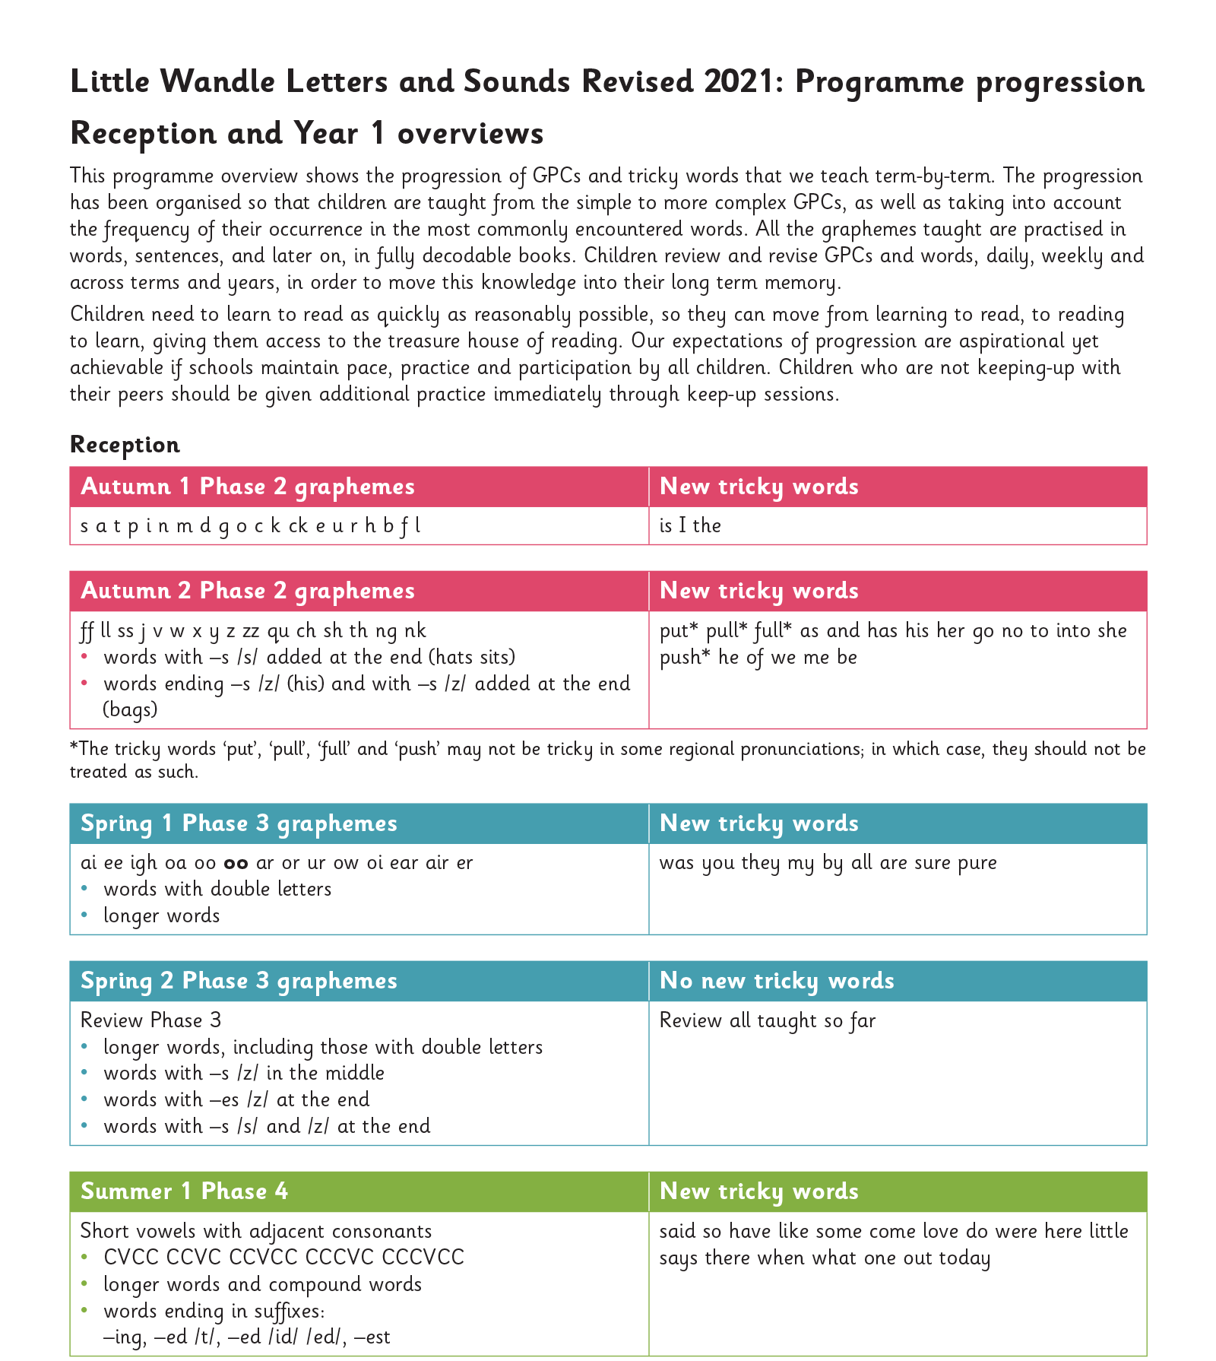
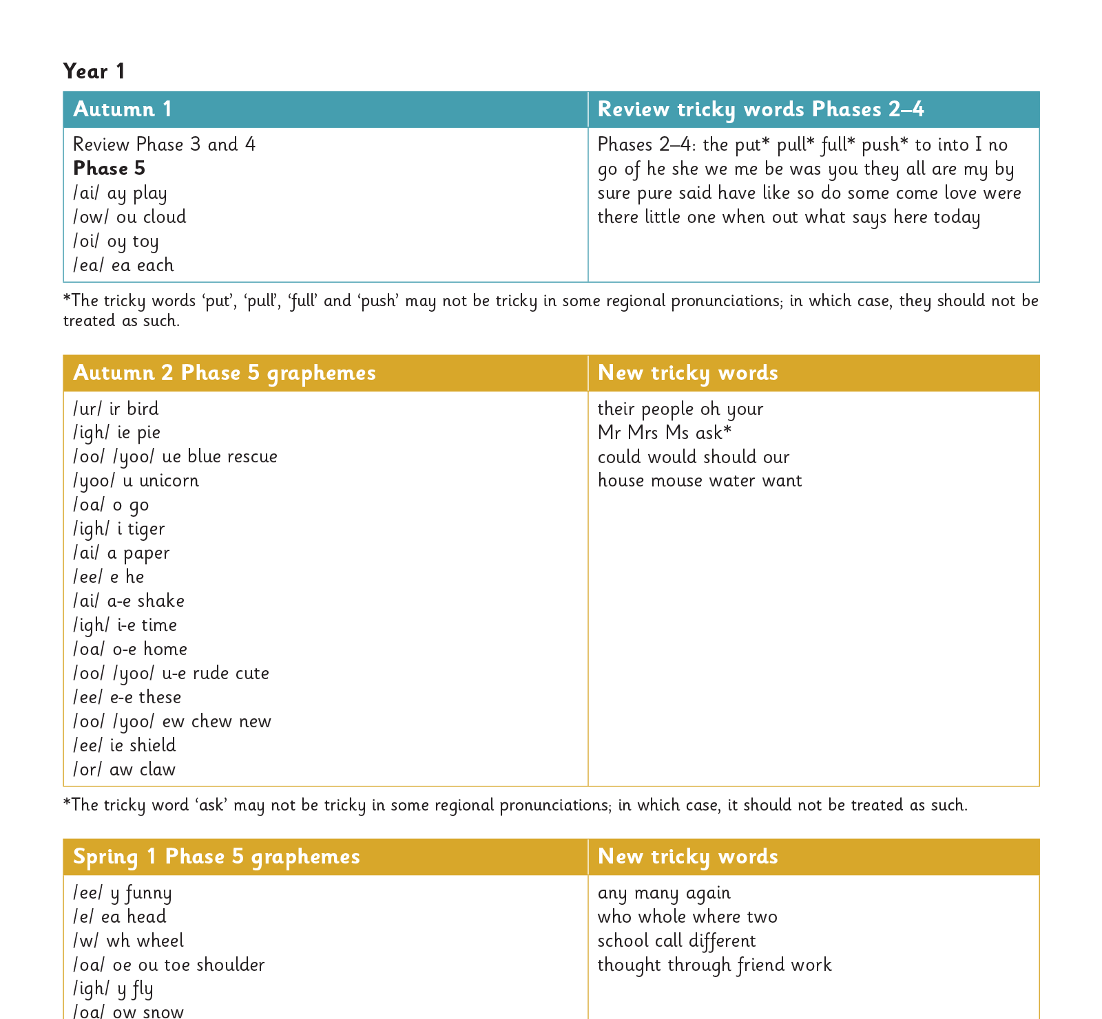
What’s next?
Notes:
Slide purpose:
To look at the Little Wandle progression beyond Phase 3
Suggested script:
After Easter the children will begin Phase 4, where they will learn to read words containing adjacent consonants (words with two or more consonants next to each other).
These include two adjacent consonants e.g. drip, jump, or three adjacent consonants e.g. strap, strong.
Children continue to have a review of the week on Fridays to secure the new learning earlier in the week.
Tricky words are taught alongside this.

Slide 11

Reading and spelling

Slide 12

This term’s spelling
This term, your child will be taught how to spell words every day using the graphemes they have been taught so far.
They will practise writing a dictated sentence.
Handwriting is referred to but is taught at other times of the day.
Notes:
Slide purpose:
To introduce spelling
Suggested script:
Increasingly challenging words to spell are introduced e.g. longer words, compound words (carpark), plurals.
This all matches the Little Wandle sequence of learning.

Slide 13

How we teach spelling – a recap
Say the word.
Segment the sounds.
Count the sounds.
Write them down.
Notes:
Slide purpose:
To recap spelling methodology
Notes:
Model the process above on a flipchart for the parents to see.
Show process with a Phase 3 word, e.g. boot, tail, teeth.

Slide 14
How do we teach reading in books?
Reading practice sessions are:
timetabled three times a week
taught by a trained teacher/teaching assistant
taught in small groups.
Books are matched to children’s level through assessments.
Notes:
Slide purpose:
To introduce decodable books
Suggested script:
The children read the same book three times in a week.
The first time we work on decoding (sounding out) the words, the second time we work on prosody which is reading with expression – making the book sound more interesting with our story-teller voice or our David Attenborough voice – and the third time we look at comprehension.
We read the books three times at school because we want to develop the fluency.
The more they see words the more they begin to read them automatically without having to sound them out.

Slide 15
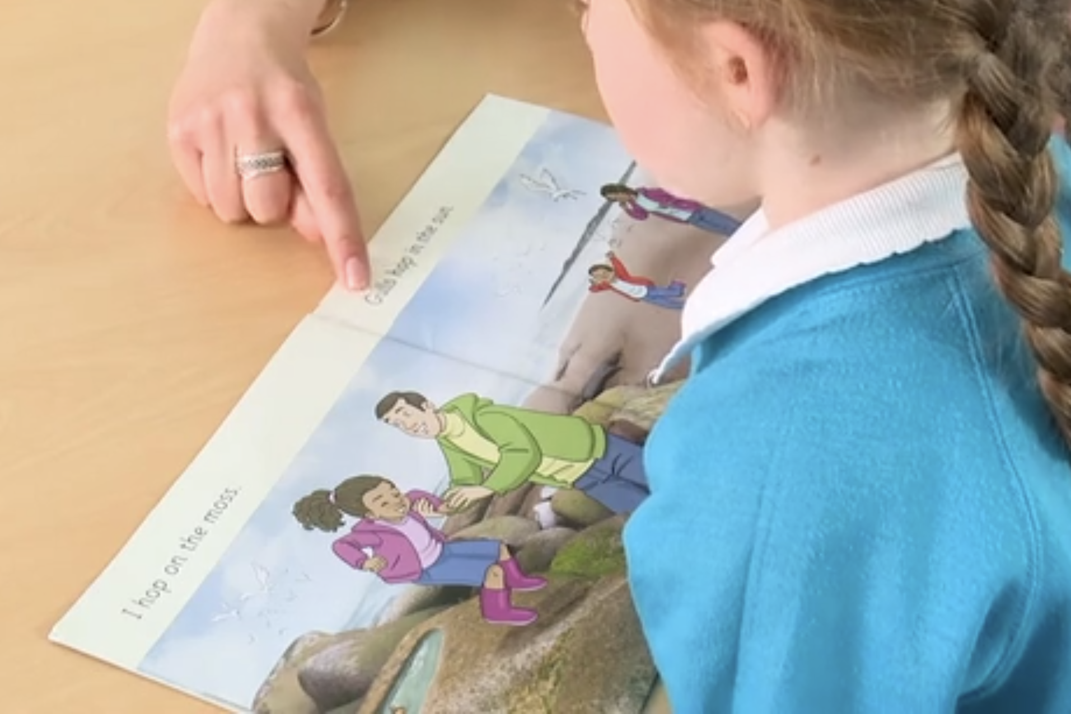
Reading a book at the right level
This means that your child should:
know all the sounds and tricky words in their phonics book well
read some of the words by silent blending (in their head), so their reading becomes automatic
stop and sound out some words by the time they bring the book home – but they should be able to do this on their own.
Notes:
Slide purpose:
To introduce book matching
Suggested script:
Whilst your child is learning Phase 3 GPCs they will be reading a Phase 2 book – as these books are at their level of security.
Once they have secured the Phase 3 GPCs and read them in words confidently, they will read a Phase 3 book.
In these books we encourage them to ‘blend in their heads’. This is a strategy that helps children to become fluent readers.
Blending in your head means children say the sounds quietly in their heads and then read the whole word out loud. Eventually, this will become automatic and children can read words that they know fluently.
We will always communicate with you if we feel that your child is not blending accurately enough yet and needs additional support.

Slide 16
Reading at home

Slide 17
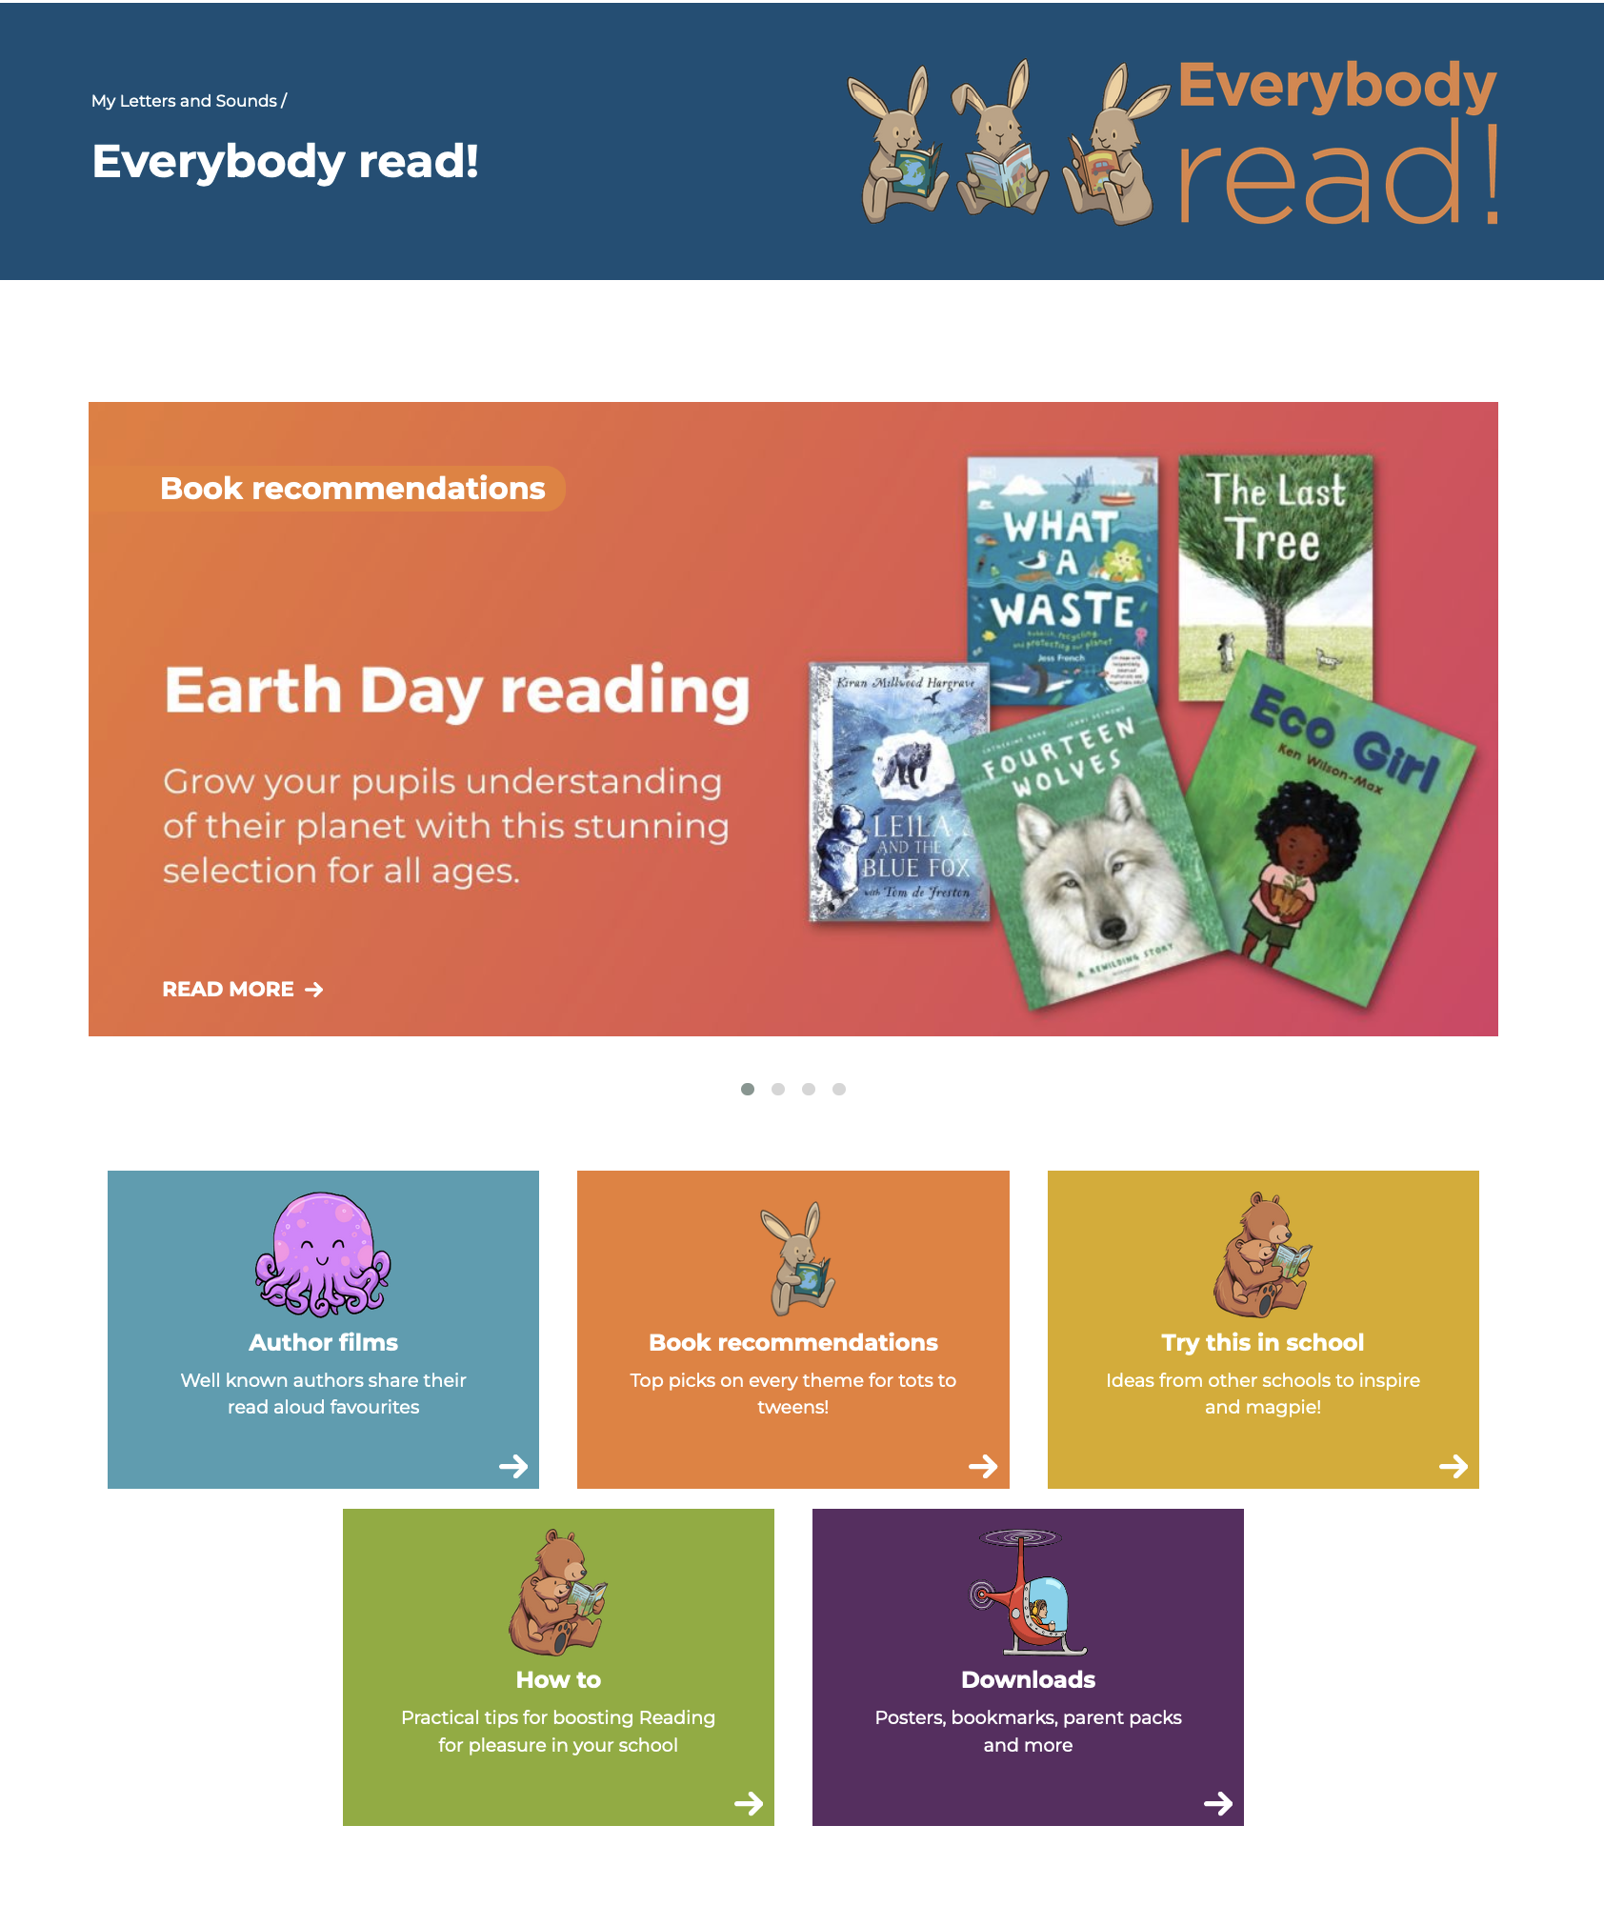
The most important thing you can do is read with your child
Reading a book and chatting had a positive impact a year later on children’s ability to …
understand words and sentences
use a wide range of vocabulary
develop listening comprehension skills.
The number of books children were exposed to by age 6 was a positive predictor of their reading ability two years later.
Little Wandle – Everybody read!
Parental involvement in the development of children’s reading skills: A five-year longitudinal study (2002) Senechal, M. and Lefvre, J
Notes:
Slide purpose:
To introduce the values of reading at home
Suggested script:
Celebrate child’s success at school.
Make time for reading at home!
The Everybody read! part of the Little Wandle website has lots of book recommendations. Anyone can access it and find lots of lovely book recommendations for their children. Click on link to show Everybody read! section of website.
Don't forget that your local library can order books for you if you really want a specific book.

Slide 18

Books going home – a reminder
Notes:
Slide purpose:
To introduce the process and format for reading at home
Suggested script:
As well as the ‘learning to read’ book that your child will bring home they will also bring home a book for sharing with you.
This shared book is SO important. This is how we are going to give them the WILL to read.
Please read with your child as often as you can – at least once a day if possible.

Slide 19
Listening to your child read their phonics book
Your child should be able to read their book without your help.
They might sound out words and blend them before they read them fluently.
If they can’t read a word, read it to them.
Talk about the book and celebrate their success.
Notes:
Slide purpose:
To give guidance on reading the decodable book at home
Notes
Read the slide.

Slide 20

Read to your child
The shared book is for YOU to read:
Make the story sound as exciting as you can by changing your voice.
Talk with your child as much as you can:
  Introduce new and exciting language.
  Encourage your child to use new vocabulary.
  Make up sentences together.
  Find different words to use.
  Describe things you see.
Notes:
Slide purpose:
To give guidance on reading the decodable book at home
Notes
Read the slide.

Slide 21
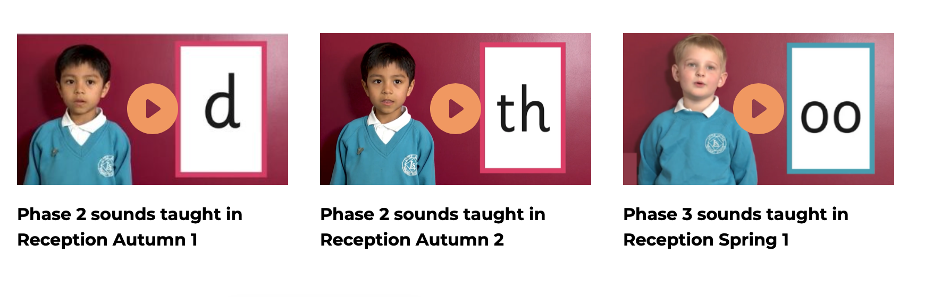


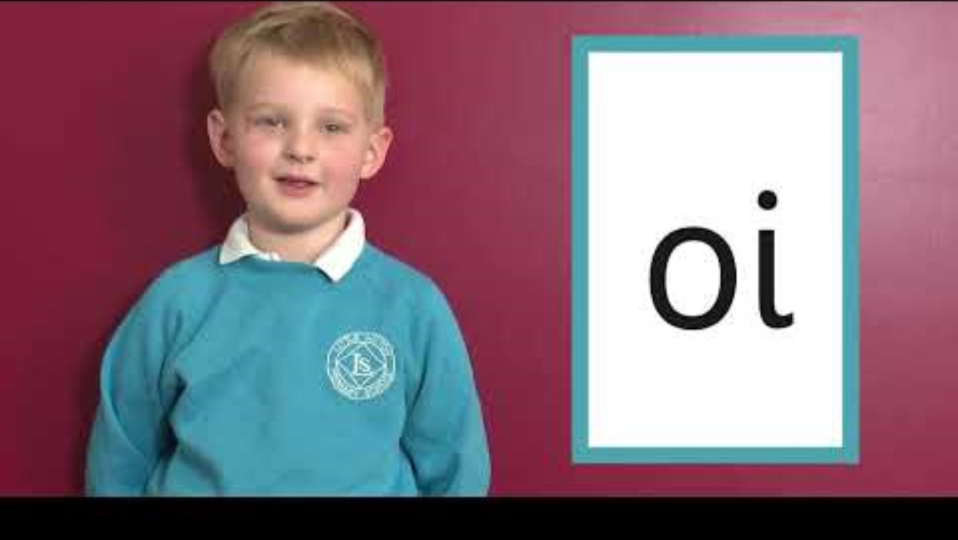
Supporting your child with phonics
Notes:
Slide purpose:
To give guidance on supporting phonics learning at home
Suggested script:
It is really important that you pronounce the sounds correctly at home if you are supporting your child.
These videos are on the website for you to refer to and if you are unsure, please ask your child’s teacher.
Show the parents where to access the videos on the website and play them! https://www.littlewandlelettersandsounds.org.uk/resources/for-parents/

Slide 22
Children are made readers on the laps of their parents.
― Emilie Buchwald
Notes:
Slide purpose:
To summarise key takeaways – final message
Notes:
Read the quote.

